Slide 1




Slide 2
inspiring innovative instruction
i3 Training Services Inc.
presents
". . .and on the 8th Day GOD Created Google!?"
www.i3trainingservices.com/trld2008.htm
Floyd Braid
TRLD- 2008
Copyright 2008 i3 Training Services Inc. All rights reserved
www.i3trainingservices.com

Slide 3
inspiring innovative instruction
Goal
Explore the Evolving (forced?) Landscape of the classroom
Investigate web enhanced research in the classroom
(The Research Process)
Explore the search tools (Google/Ask/?)
Participate in a Modeled Lesson
Broader Goal?-
Doing something different utilizing new tools.
Copyright 2007 i3 Training Services Inc. All rights reserved
www.i3trainingservices.com

Slide 4
inspiring innovative instruction
Fools Goal?
This is about how we do what we do, if walking across the room works just fine why would we do it another way?
Can I change the way I do something so that I guarantee maximum impact?
Copyright 2007 i3 Training Services Inc. All rights reserved
www.i3trainingservices.com

Slide 5
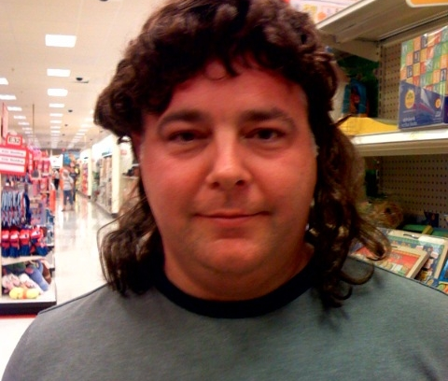
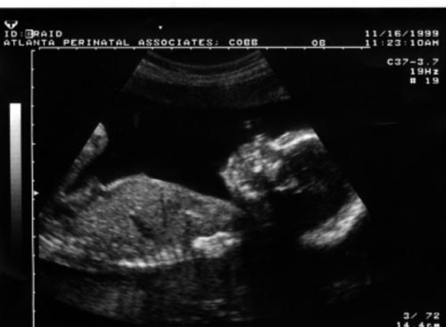
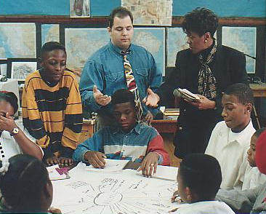
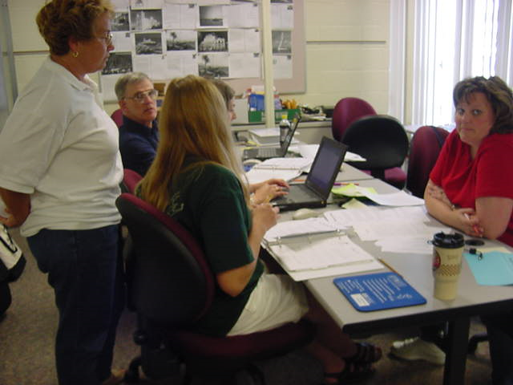
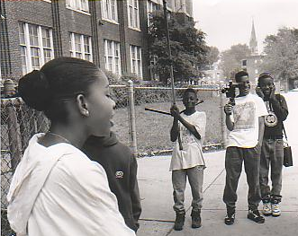
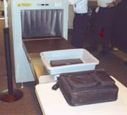

Meet the Presenter
When I was young…
I had hair
Middle School Educator
College Educator
School Administrator
State of Denial Department
Company Man
Coach

Slide 6
inspiring innovative instruction
Horse With Saltines
“You can lead/drag a horse to water but you can’t make him drink, you can coerce, threaten and beat him but he still won’t drink. However, if you make him thirsty…goal accomplished!”
Copyright 2007 i3 Training Services Inc. All rights reserved
www.i3trainingservices.com

Slide 7
inspiring innovative instruction
Change is Personal
Copyright 2007 i3 Training Services Inc. All rights reserved
www.i3trainingservices.com

Slide 8
inspiring innovative instruction
“You Can’t Create Change Without the Image of Change”
Copyright 2007 i3 Training Services Inc. All rights reserved
www.i3trainingservices.com

Slide 9
inspiring innovative instruction
Change
Forced
Faked
Forever
Copyright 2007 i3 Training Services Inc. All rights reserved
www.i3trainingservices.com

Slide 10
inspiring innovative instruction
Change
Forced
No other option you must do it this way…attendance, grades, email. Forced with out an opt out option + support almost always works.
Don’t expect much creativity!
Won’t change the inner dialogue of the learner!
Faked
Sit & get but no follow through or accountability. New software roll out, new equipment… I’ll do it as long as I’m being watched. Almost never works. Don’t expect much creativity!
Copyright 2007 i3 Training Services Inc. All rights reserved
www.i3trainingservices.com

Slide 11
inspiring innovative instruction
Change
Forever
No change is forever.
However, there is change forever!
The Keys
1. Change Must Start With The Individual
2. Detailed Goals & Objective
3. Support from Learning Community
4. Unlock the Paradoxical Dilemma
Copyright 2007 i3 Training Services Inc. All rights reserved
www.i3trainingservices.com

Slide 12
inspiring innovative instruction
Start With the Goal
First we must agree on a noble objective.
Skills? Integration? Curriculum?
Focus on Teacher?
Focus on Student?
What are we trying to accomplish?
Copyright 2007 i3 Training Services Inc. All rights reserved
www.i3trainingservices.com

Slide 13
inspiring innovative instruction
Mastering the New Skills
We want digital immigrants to
think like digital natives!
To feel comfortable making different choices using new tools. Using the most appropriate tools to deliver/enhance our instruction.
Copyright 2007 i3 Training Services Inc. All rights reserved
www.i3trainingservices.com

Slide 14
inspiring innovative instruction
The Internet
“The Internet is like a herd of performing elephants with diarrhea -- massive, difficult to redirect, awe-inspiring, entertaining, and a source of mind- boggling amounts of excrement when you least expect it."
Copyright 2007 i3 Training Services Inc. All rights reserved
www.i3trainingservices.com

Slide 15
inspiring innovative instruction
The Internet
“Spending an evening on the Internet is much like sitting down to a dinner of Cheese Curls. Two hours later your fingers are yellow and you're no longer hungry, but you haven't been nourished."
Copyright 2007 i3 Training Services Inc. All rights reserved
www.i3trainingservices.com

Slide 16


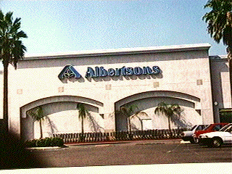
inspiring innovative instruction
The Search Engine
www.google.com www.yahoo.com www.profusion
www.altavista.com www.ask.com www.dogpile.com
How they work!
Work Them Don’t Let Them Work You!
Copyright 2007 i3 Training Services Inc. All rights reserved
www.i3trainingservices.com

Slide 17



inspiring innovative instruction
The Search Engine
Work Them Don’t Let Them Work You!
Copyright 2007 i3 Training Services Inc. All rights reserved
www.i3trainingservices.com

Slide 18
inspiring innovative instruction
Confirm Your Facts!
Confirming Facts
    total water supply of the world is 326 million cubic miles
      Rephrase
      Quote the fact then check the source
      Ask the question
      Non-tech sources (The old encyclopedia, text books & periodicals)
Require Multiple Resources
Copyright 2007 i3 Training Services Inc. All rights reserved
www.i3trainingservices.com
Copyright 2006 i3 Training Services Inc. All rights reserved
www.i3trainingservices.com

Slide 19
inspiring innovative instruction
Evaluate Your Info!
Defining Web Literacy Skills
Scope – Authority & Bias – Permanence - Timeliness
Scope
  Is there a stated purpose of the site
  Who is the intended audience for the site
  How comprehensive is the site
Copyright 2007 i3 Training Services Inc. All rights reserved
www.i3trainingservices.com

Slide 20
inspiring innovative instruction
Evaluate Your Info!
Defining Web Literacy Skills
Authority & Bias
  Who provided the information and why
  What credentials do they have
  Is the provider affiliated with a known organization
  Is a point of view being "sold" to the user
  Can you find explicit statements of authority - such as a statement of institutional support.
Copyright 2007 i3 Training Services Inc. All rights reserved
www.i3trainingservices.com

